Slide 1
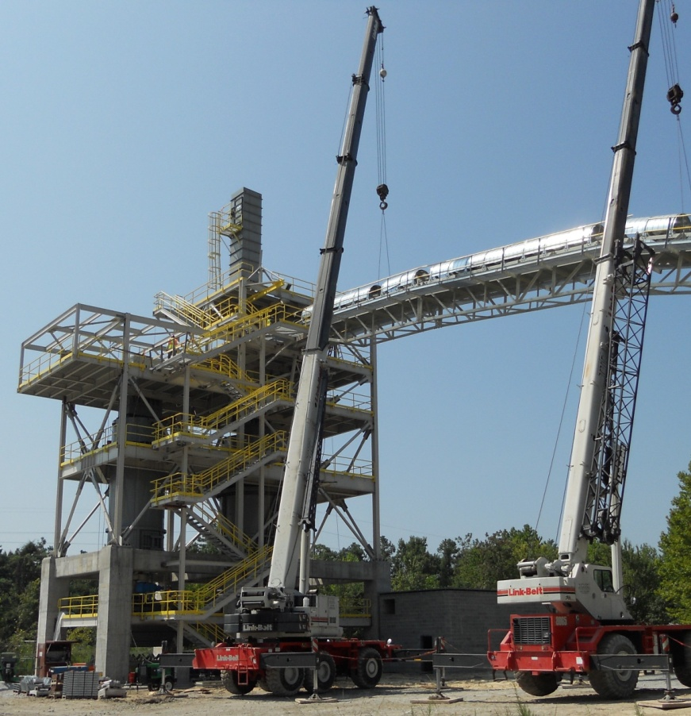

CEMENT PROJECT – ARGOS
(Harleyville, South Carolina)
Project: Argos – Clinker Reclaim
Harleyville, South Carolina
J14106
Scope: Structural Steel Erection
Conveyor Installation
Bucket Elevator Installation
Limestone and Gypsum Bin
Installation
Project Equipment:
Two Welded Bins
Four Structural Steel Towers
100’ Bucket Elevator
Over 1300’ of Conveyors

Slide 2
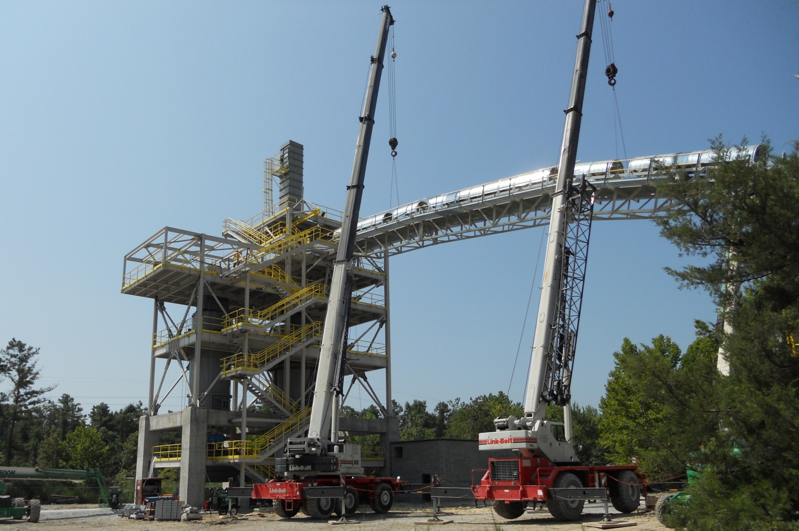
CEMENT PROJECT – ARGOS
(Harleyville, South Carolina)
Additive Feed Bin Building & Conveyor

Slide 3
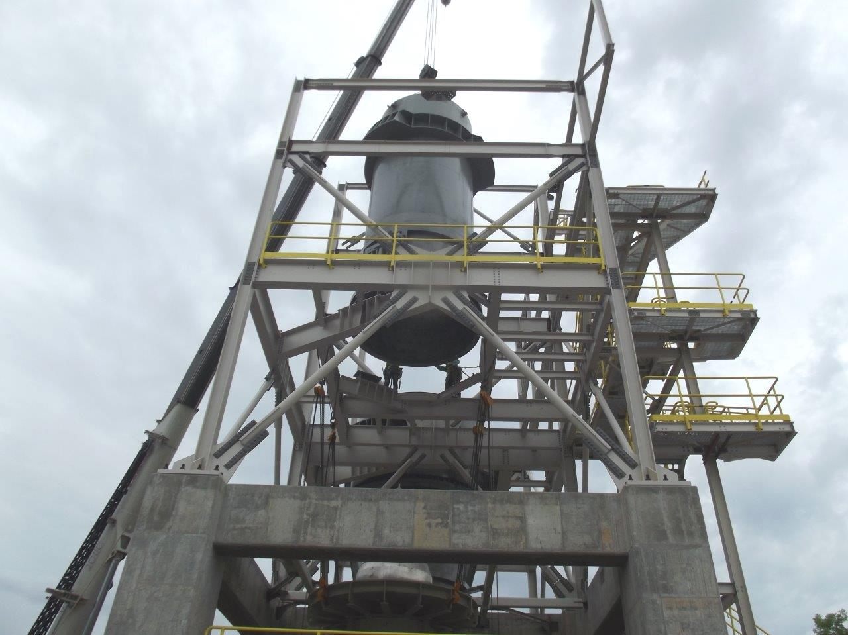
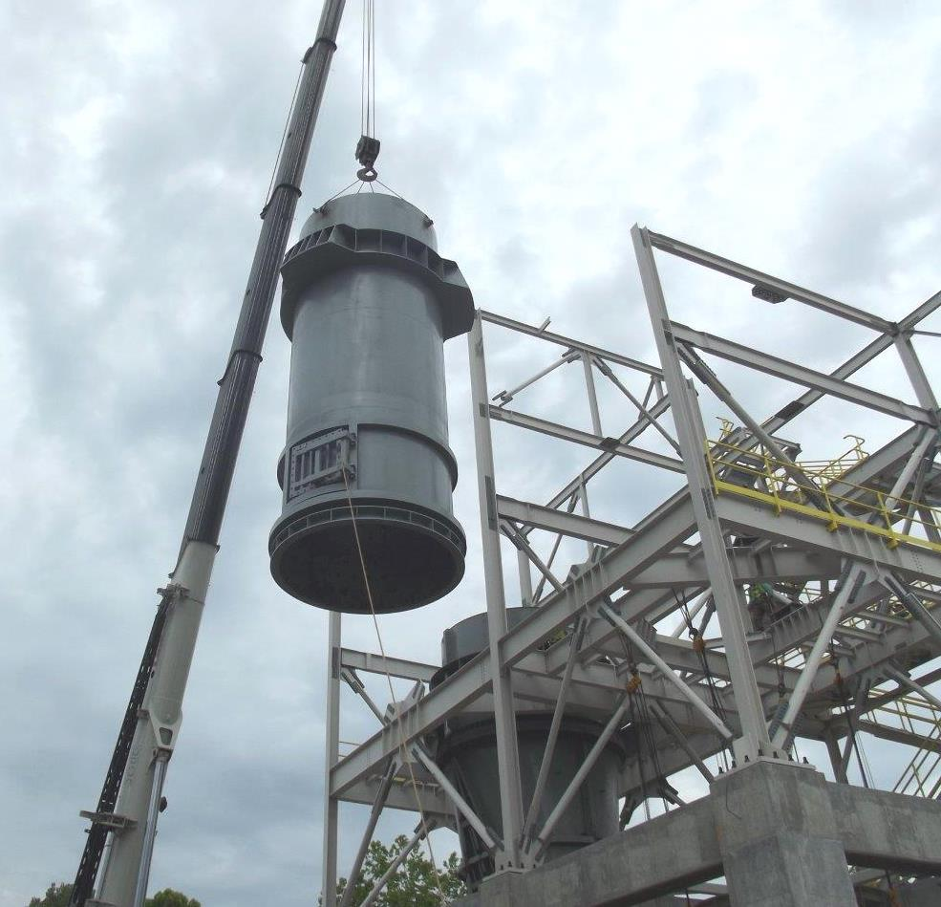
CEMENT PROJECT – ARGOS
(Harleyville, South Carolina)
Limestone Bin Installation

Slide 4
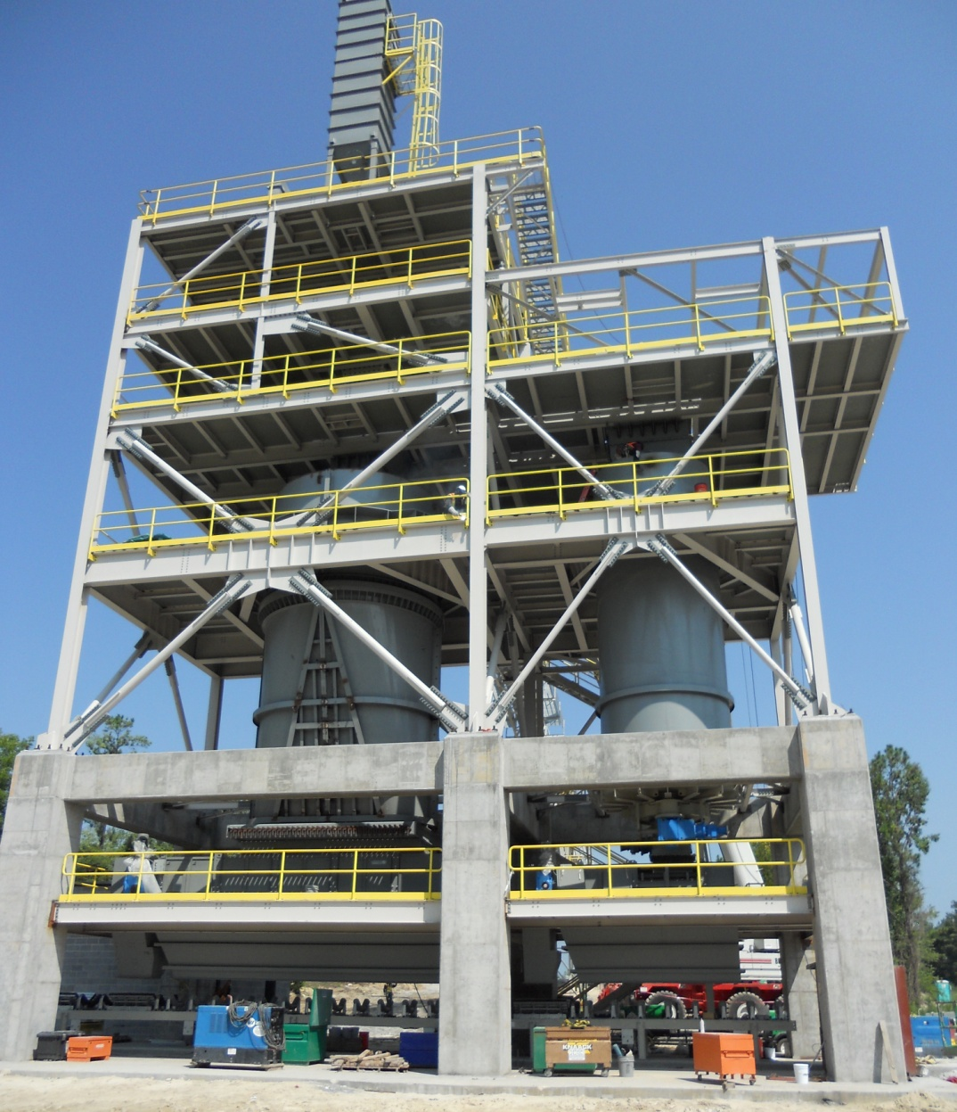
CEMENT PROJECT – ARGOS
(Harleyville, South Carolina)
Additive Feed Bin Building

Slide 5
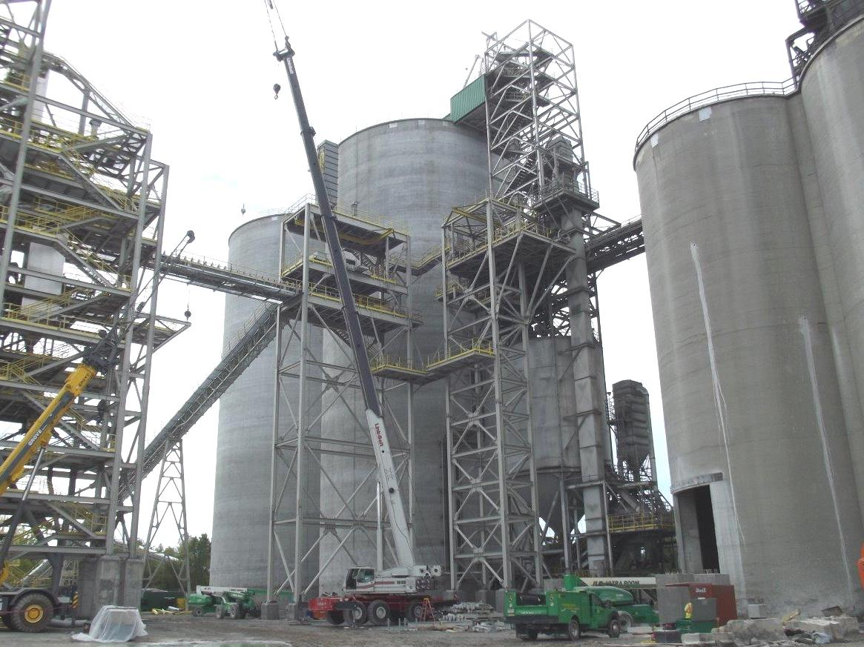
CEMENT PROJECT – ARGOS
(Harleyville, South Carolina)
Clinker Tower #1 and Additive Transfer Tower

